Slide 1
What does infectious disease look like in the mind? A reverse correlation approach
Nicholas Michalak
Joshua Ackerman
Notes:
Hi, my name’s Nick Michalak and I work with Josh Ackerman at the University of Michigan. I’m interested in how people perceive infectious disease.

Slide 2
Think of someone who would get you sick…
What does
this person look like?
True infection | False infection
True healthy | False healthy
Less
costly
More
costly
Haselton & Buss (2000)
Notes:
To get a feel for what I mean, just take a second and think to yourself, what comes to mind when you picture someone who might get you sick?
My prediction is that, whoever or whatever you’re imagining right now, the features that you see are not exhaustive diagnostic cues of infectious disease. That’s because harmful pathogens and the symptoms they cause in people are practically infinite; it would be impossible for you to develop a truly accurate portrait of what all disease looks like. One potential evolutionary solution to this problem is to cut corners; ‘play it safe’ and assume that anyone who looks or acts kinda’ strange is going to get you sick.

Slide 3
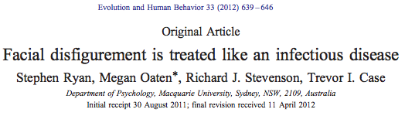
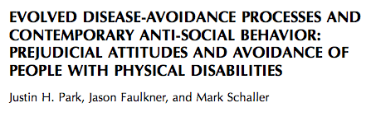
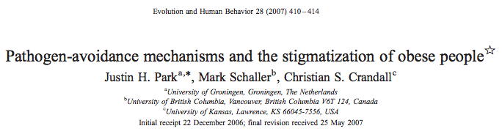
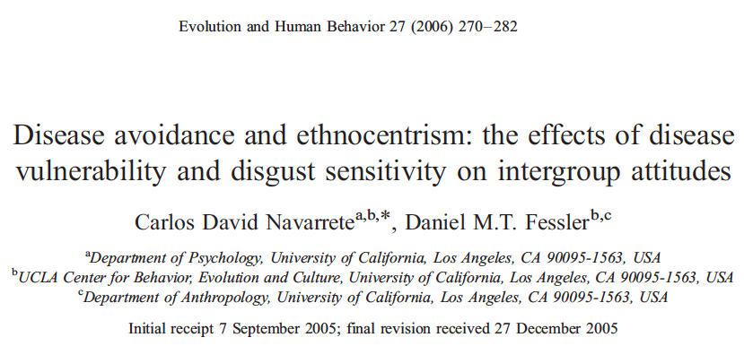
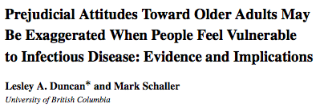
Generate mental image of infected person
Measure threat-specific features
Test whether features motivate intentions to avoid
Notes:
This assumption has fueled a growing body of literature suggesting that whether people are chronically or incidentally threatened by infectious disease, they tend to respond to people with strange or atypical features as if these individuals are infected. For example, one series of experiments demonstrated that disease threat can increase attention toward disfigured faces; other studies have linked disease threat to xenophobia and anti-fat attitudes.
So, people seem to respond to these atypical features as if they signal infectious disease, but we don’t know which facial features naturally emerge when people think about someone who is infected. So, in our research, wanted to know…
First, what does an infected person look like in the minds of participants?
Second, does this mental image have generally negative features, or are its features specific to pathogen threats?
Finally, given what this image looks like, does it motivate adaptive behavior? So, does it look like someone you’d want to stay away from?

Slide 4
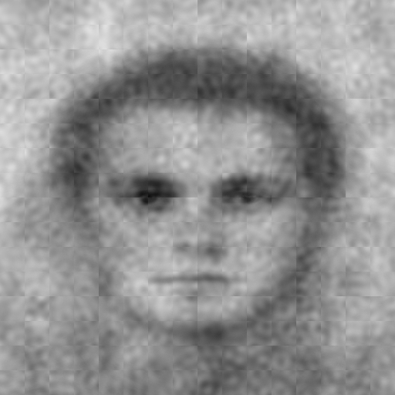
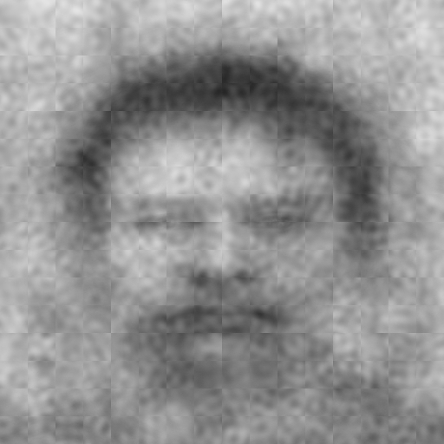
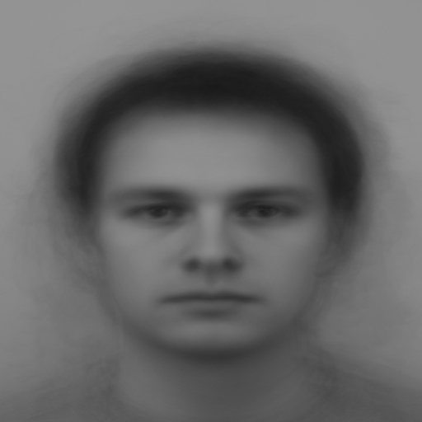
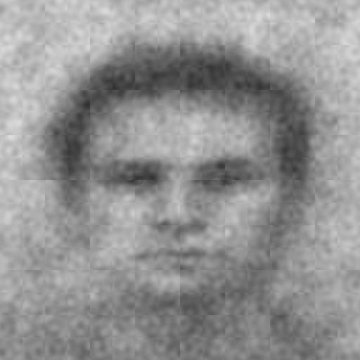
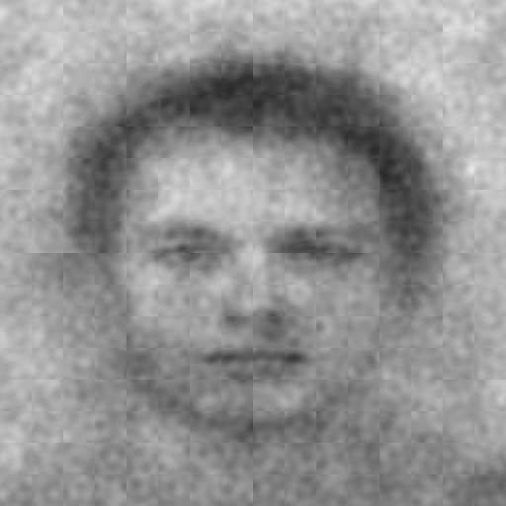
Michigan undergraduates
(N = 94)
anti-Germy
Germy
Base image
+/-
Random noise
Which face looks more germy?
400 picks
Generated using rcicr (Dotsch, 2016)
TurkPrime (N = 269)
Litman, Robinson, & Abberbock, 2016
Physical Traits
Germy
Disfigured
Heavy
Old
Foreign
Character Traits
Violent
Arrogant
Incompetent
Trustworthy
If you were to meet
in real life...
…how much would you want to
avoid physical contact...
...how willing would you be
to stand near…
Pre-registered at
aspredicted.org
Notes:
In our first step to address these questions, we had Michigan undergraduates participate in a reverse correlation task, which allowed us to generate mental images of an infected person without making any assumptions about what those images look like.
Participants selected the more ‘germy’ face among 400 pairs of faces whose features have been garbled with random noise masks.
After data collection, we used their selections to create their mental image of germy. Here's what we get.
The image on the right is an average of the images participants selected as more germy. The image on the left is anti-image: this is an average of the images participants did not select as more germy.
In order to measure the features of these images, in the second phase of this study, we pre-registered an MTurk survey in which participants were randomly assigned to rate either the germy image or the not germy image.
Participants rated the images on physical traits: germy, disfigured, heavy, old, and foreign, which represent traits that have been linked to disease threat throughout the behavioral immune system literature. We predicted that the germy mental images would be rated higher along these dimensions, compared to the anti-image.
They also rated the images on character traits: violent, arrogant, incompetent, and trustworthy. Since these traits are not directly linked to disease threat, we predicted the germy mental images would receive relatively similar ratings along these dimensions, compared to the anti-image, though we did predict lower ratings for trustworthy.
Finally, participants rated how much they’d want to avoid and how willing they’d be to stand near the people in the images. We predicted that the degree to which germy mental images were rated along atypical physical dimensions would mediate increased intentions to avoid the people in the images.

Slide 5
Classification Image
anti-Germy
Germy
Trustworthy
Incompetent
Arrogant
Violent
Foreign
Old
Heavy
Disfigured
Germy
0
1
2
3
4
5
6
7
8
Not at all
Extremely
Means and 95% CIs (ggplot2; Wickham, 2009)
Rating
Notes:
The results were fairly consistent with our predictions. On this graph, trait ratings are on the y-axis and the x-axis depicts the full rating scale, from not at all to extremely. Ratings for the germy face are red. As predicted, MTurkers tended to rate the germy faces as more germy, disfigured, heavy, old, and foreign than the not-germy faces. However, MTurkers made much weaker distinctions between the faces along the character trait dimensions like violent, arrogant, and incompetent.

Slide 6
Germy = 1
anti-Germy = -1
c
Avoidance Index
.383, 95% CI [.066, .678]
Total effect
Disfigured
Rating
a₁
b₁
Germy = 1
anti-Germy = -1
c’
Avoidance Index
.189, 95% CI [-.072, .520]
Direct effect
Latent variable
‘Want to avoid’
‘Willing to stand near’
(reverse-coded)
Disfigured_{Indirect} = .194, 95% CI [.096, .319]
Indirect effect
Model run using lavaan (Rosseel, 2012)
Notes:
We wanted to know whether these trait ratings mediated people’s intentions to avoid the people in the images. Not only did MTurkers report greater intentions to avoid the germy person, but their intentions were mediated by their disfigurement ratings. We find similar indirect effects for many of the other physical ratings.

Slide 7
The germy mental image possesses features that serve as heuristic cues to infectious disease threat
anti-Germy
Germy
These features may motivate avoidance
Notes:
Taken together, these results suggest that when people imagine someone who poses a pathogen threat, their mental images have features that are specific to infectious disease threats, and these images can potentially motivate people to avoid this infected person who they’re imagining.

Slide 8
Thank you
Contact: nickmm@umich.edu

Slide 9
References
Dotsch (2016). rcicr: Reverse correlation image classification toolbox. R package version 0.3.4.1.
Duncan, L. A., & Schaller, M. (2009). Prejudicial attitudes toward older adults may be exaggerated when people feel vulnerable to infectious disease: Evidence and implications. Analyses of Social Issues and Public Policy, 9(1), 97-115.
Haselton, M. G., & Buss, D. M. (2000). Error Management Theory: A New Perspective on Biases in Cross-Sex Mind Reading. Journal of Personality and Social Psychology, 78(1), 81-91.
Litman, L., Robinson, J., & Abberbock, T. (2016). TurkPrime.com: A versatile crowdsourcing data acquisition platform for the behavioral sciences. Behavior Research Methods, 1-10.
Navarrete, C. D., & Fessler, D. M. (2006). Disease avoidance and ethnocentrism: The effects of disease vulnerability and disgust sensitivity on intergroup attitudes. Evolution and Human Behavior, 27(4), 270-282.
Park, J. H., Faulkner, J., & Schaller, M. (2003). Evolved disease-avoidance processes and contemporary anti-social behavior: Prejudicial attitudes and avoidance of people with physical disabilities. Journal of Nonverbal Behavior, 27(2), 65-87.
Park, J. H., Schaller, M., & Crandall, C. S. (2007). Pathogen-avoidance mechanisms and the stigmatization of obese people. Evolution and Human Behavior, 28(6), 410-414.
Rosseel, Y. (2012). lavaan: An R package for structural equation modeling. Journal of Statistical Software, 48(2), 1-36.
Ryan, S., Oaten, M., Stevenson, R. J., & Case, T. I. (2012). Facial disfigurement is treated like an infectious disease. Evolution and Human Behavior, 33(6), 639-646.
Wickham, H. (2009). ggplot2: Elegant graphics for data analysis. Springer Science & Business Media.

Slide 10
Classification Image
anti-Germy
Germy
Belief in a Dangerous World
Germ Aversion
8
7
6
5
Germy (0 = Not at all to 8 = Extremely)
4
3
2
1
0
Low (0-33%)
Moderate (33-66%)
High (66-99%)
Low (0-33%)
Moderate (33-66%)
High (66-99%)
Percentile of Individual Difference
Plots made with ggplot2 (Wickham, 2009)

